Slide 1
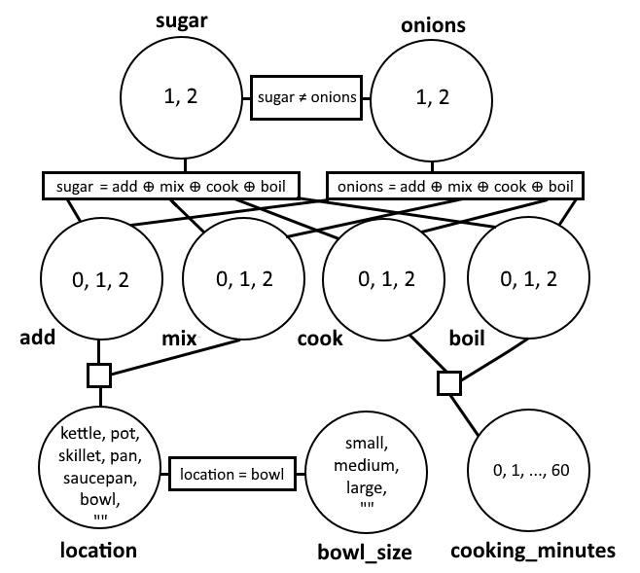
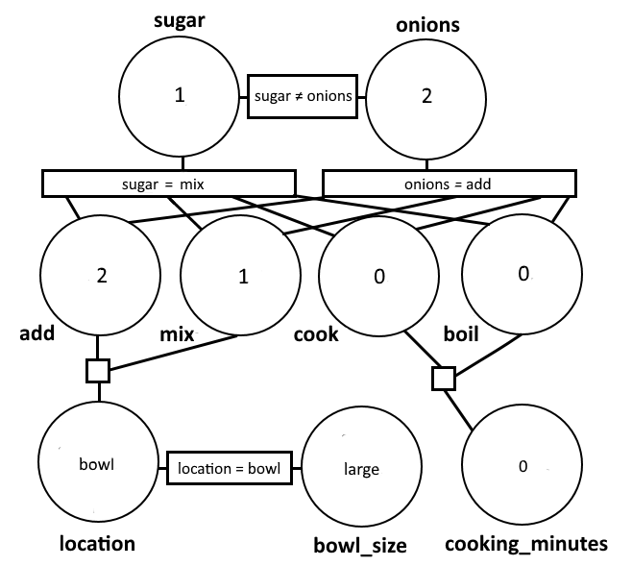
Ingredients to Recipes: CSP Generated Instructions
Kaylee Bement, Henry Lin, Nikki Taylor
Introduction
Methods and Results
Discussion and Conclusion
Problem
provide set of ingredients → get ordered set of instructions for a recipe
Instruction Format
<action> <ingredient> <action qualifier>
Example: cook pasta for 10 minutes
Backtracking vs Beam Search
On 2 ingredients
Backtracking: ~3 mill operations
Beam Search: 27 operations
Evaluation of Instructions
Features are tuples of verb, ingredient, qualifiers
Weights are created using dataset & determined by frequency
Evaluation function = sum of relevant weights ÷ number of ingredients
Example
Recipe: mix sugar in large bowl. add onions in large bowl.
Evaluation Score: 13,085.5
Based on our human evaluations and evaluation function, requesting fewer ingredients results in a recipe that makes more sense
Requesting ingredients that are commonly used for a certain action are often paired correctly (e.g. whisk eggs)
Ingredients that are commonly used together for many recipes were more often in a correct order (e.g. ingredients commonly used in baking)
Dataset and Methods
Dataset
Epicurious Recipes from Kaggle, containing 20,050 recipes
CSP
We refer to the last 3 variables as “qualifiers”
Constraints
-Each ingredient assigned to a unique instruction number
-Each ingredient has an action
Weighted factors
-Ingredient-verb pairs -Ingredient order
-Verb order -Qualifier-action pairs
Future Work
Extend CSP model to add more information to recipe (e.g. quantity)
Add form of exploration vs exploitation to help innovate recipes, mimicking human creativity
Compare runtime and outputs of CSP to other methods such as MDPs or RNNs
Modify ingredient domains to allow for multiple ingredients in each instruction
Variables | Domain
Requested ingredient | 1 to number of ingredients
Possible action | 0 to number of ingredients
Where to put ingredient | bowl, skillet, pot, kettle, saucepan, pan, “”
Cook time (in minutes) | 0 to 60
Bowl size | small, medium, large, “”
References
→
[1] Chloé Kiddon, Ganesa Thandavam Ponnuraj, Luke Zettlemoyer, and Yejin Choi. 2015. Mise en Place: Unsupervised Interpretation of Instructional Recipes. Proceedings of the 2015 Conference on Empirical Methods in Natural Language Processing(2015). DOI:http://dx.doi.org/10.18653/v1/d15-1114
[2] Jiwei Li, Will Monroe, Tianlin Shi, Sébastien Jean, Alan Ritter, and Dan Jurafsky. 2017. Adversarial Learning for Neural Dialogue Generation. (September 2017).
[3] Sosuke Amano, Kiyoharu Aizawa, and Makoto Ogawa. 2015. Food Category Representatives: Extracting Categories from Meal Names in Food Recordings and Recipe Data. 2015 IEEE International Conference on Multimedia Big Data(2015). DOI:http://dx.doi.org/10.1109/bigmm.2015.54

